Slide 1
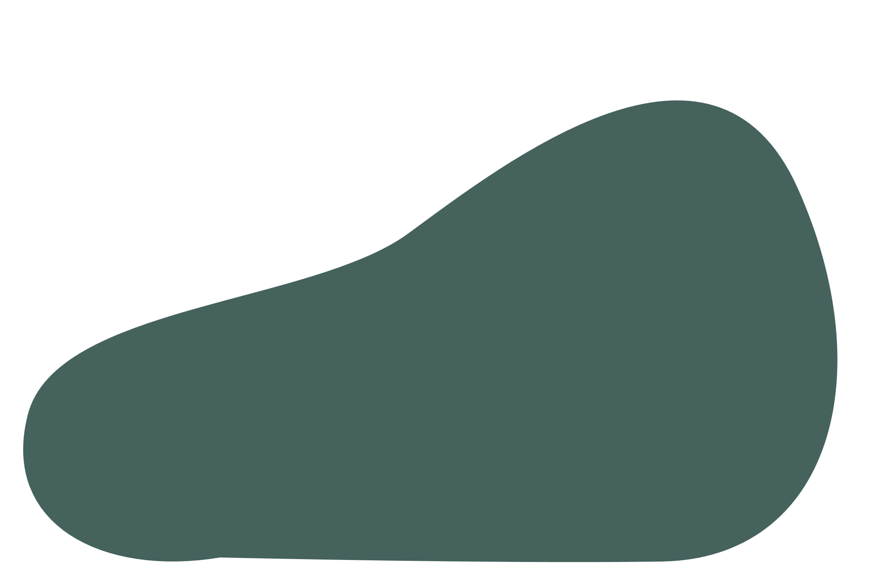
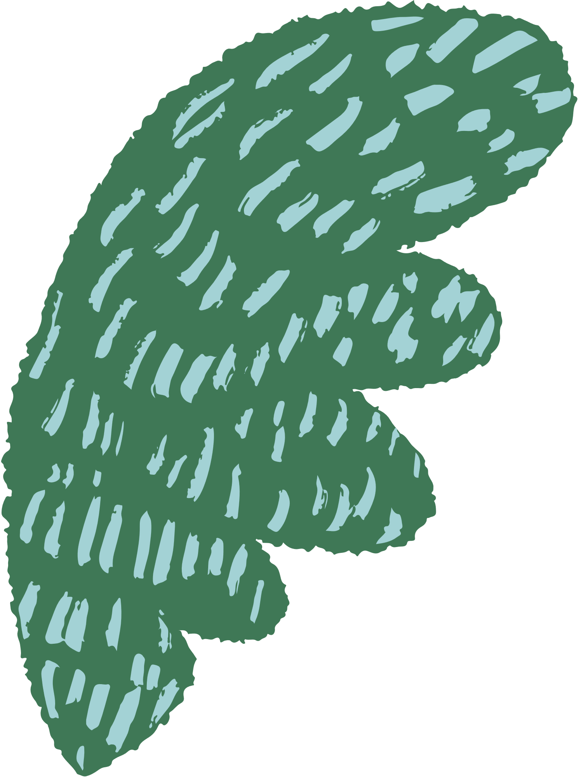


Fin Flow
Understanding Social Behaviour in Fish - Tracking, Position Analysing, Mirror Biting Tests
Siddharth Sarwate (582)

Slide 2


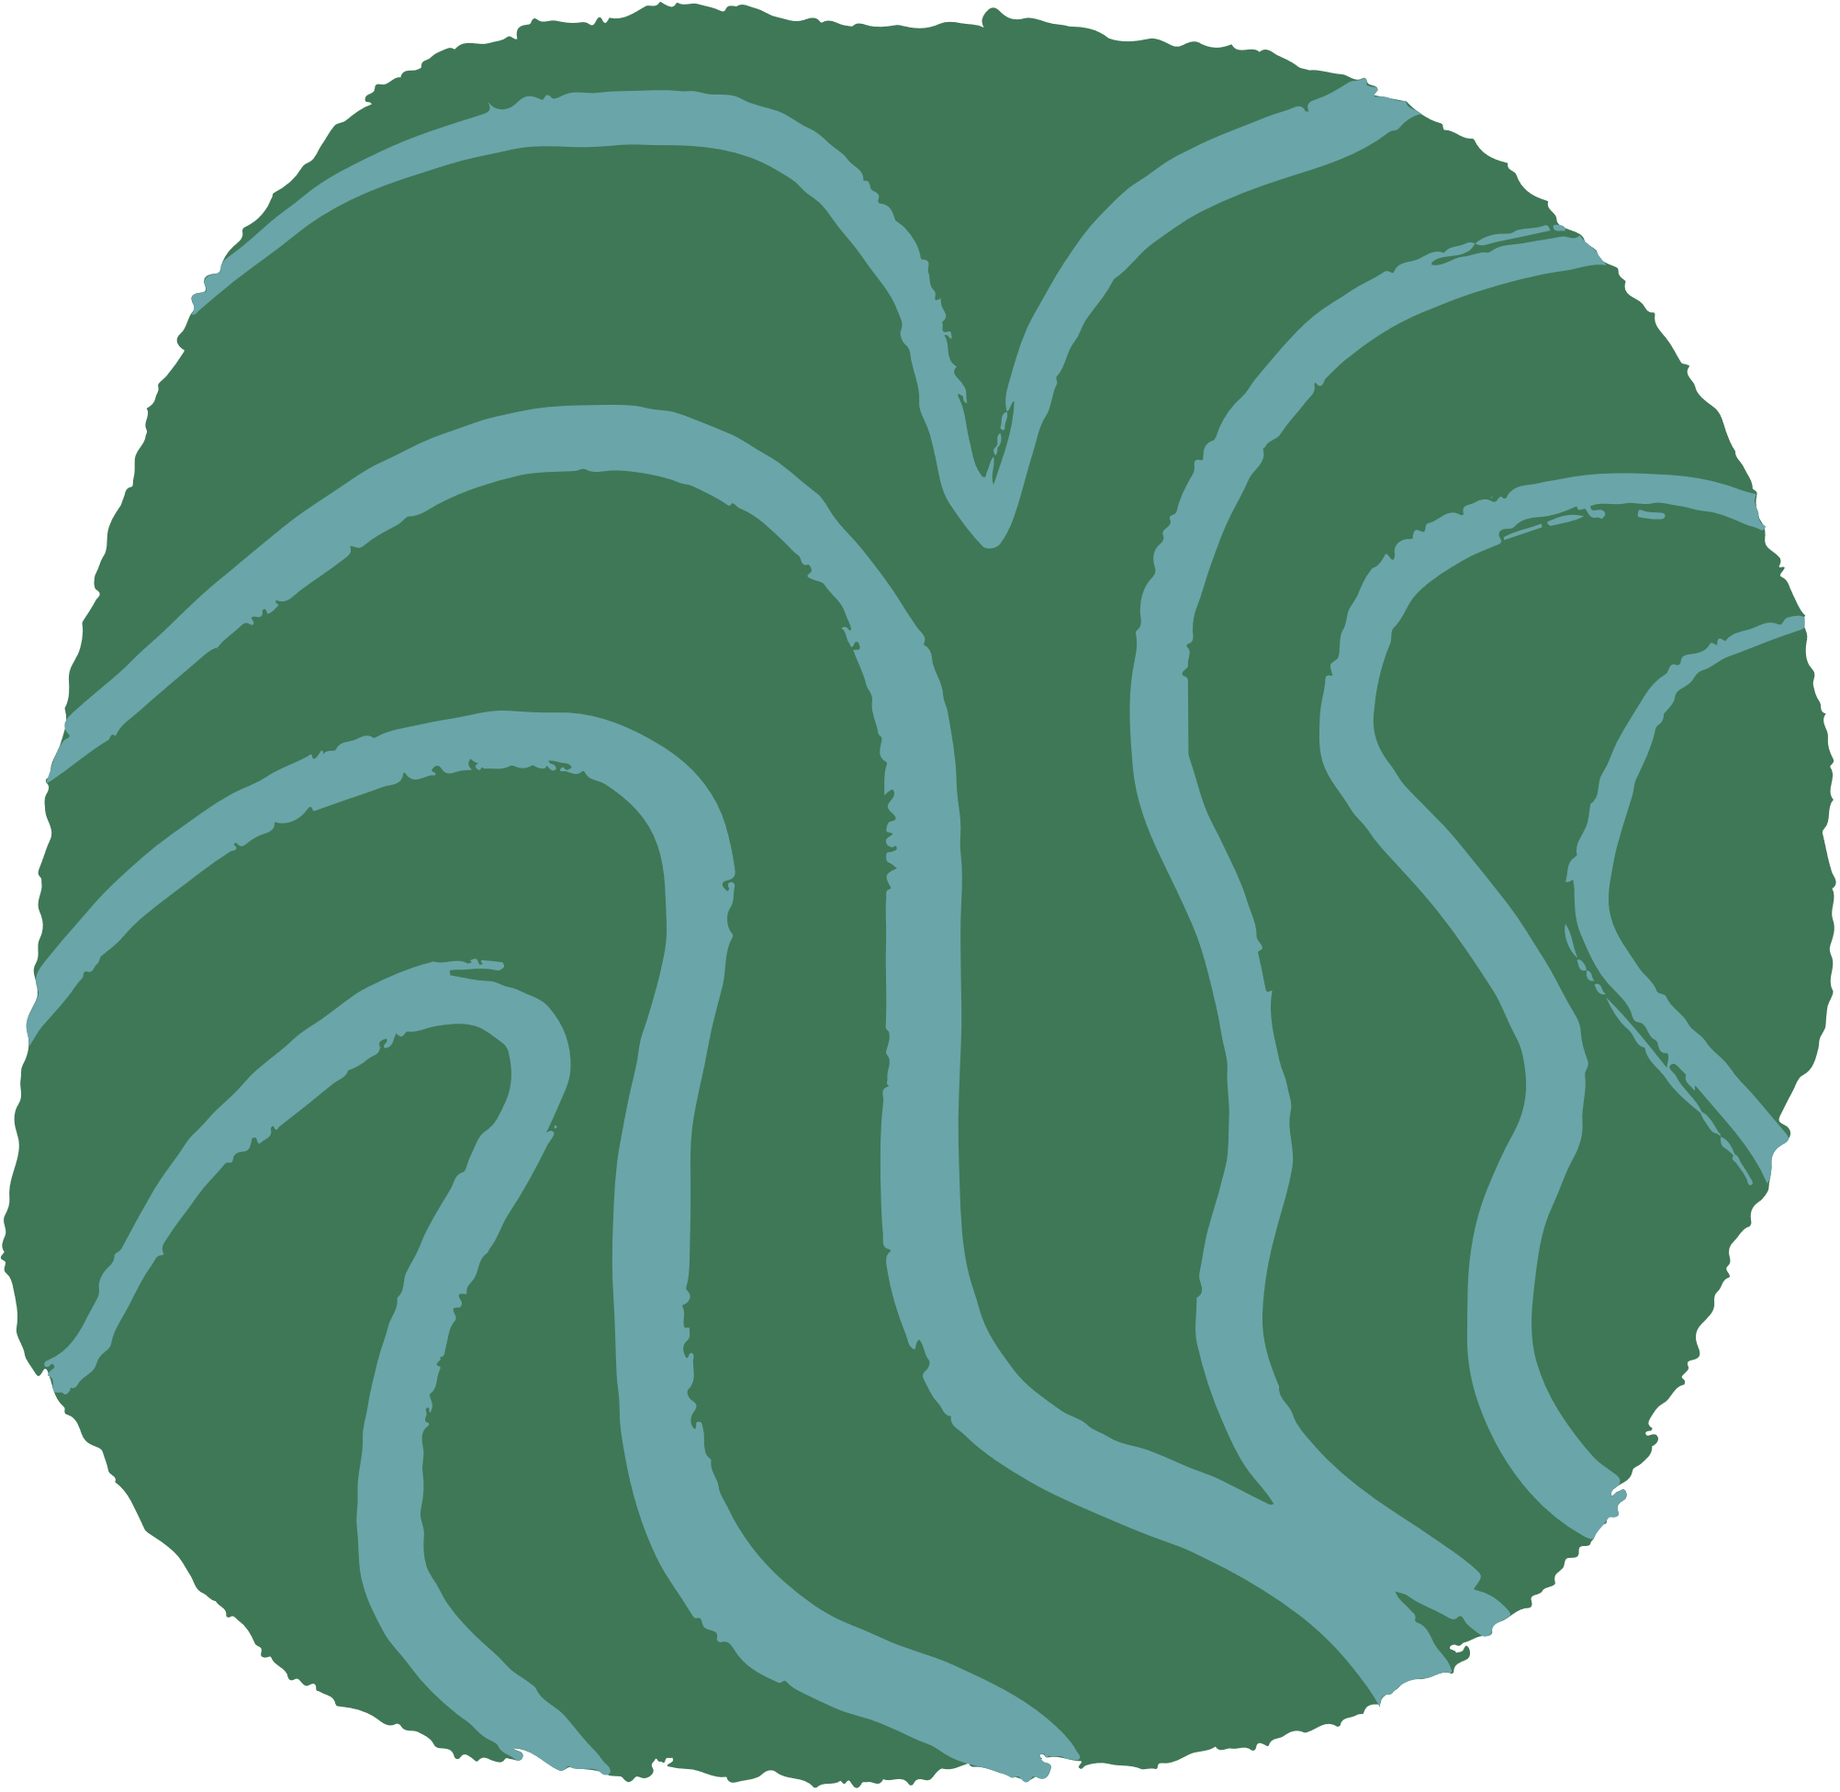

Abstract
Tracking and analysing the behaviour of fish is essential for various scientific and practical applications, such as aquatic research, underwater robotics, behaviour research.
These abstract outlines a method for tracking zebrafish and studying their behaviour using Channel and Spatial Reliability Tracker (CSRT) algorithm, a robust object tracking algorithm provided by OpenCV library.

Slide 3
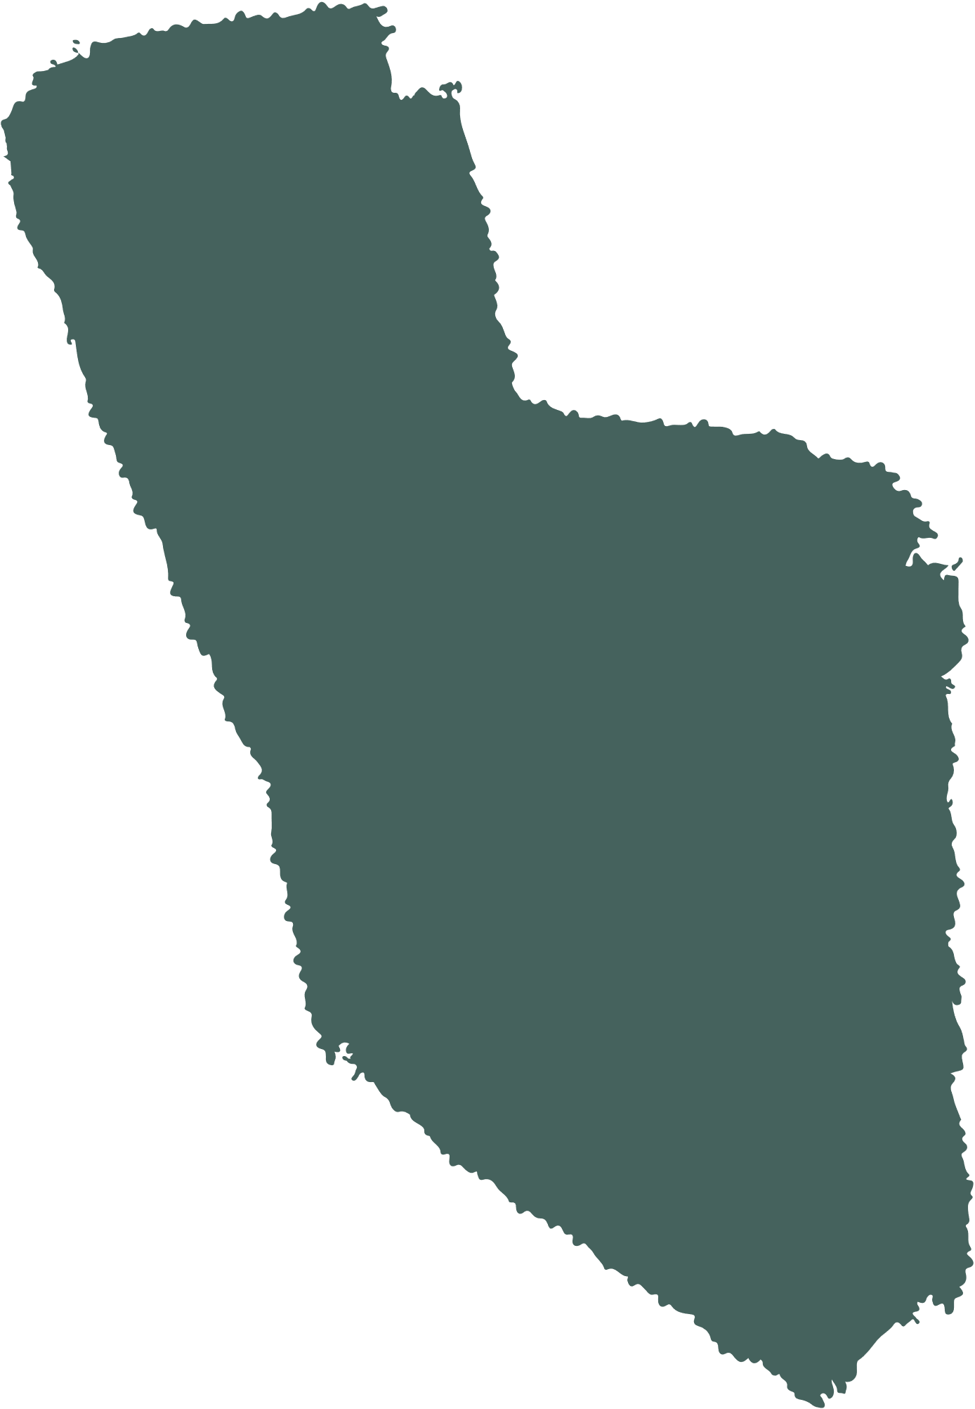



Introduction
The proposed approach begins with video data acquisition of fish in their natural or control environment. CSRT tracker is initialized by selecting a region of interest (ROI) . As the video progresses the CSRT tracker robustly tracks the fish across consecutive or subsequent frames, providing accurate position information.
Behaviour analysis is conducted by analysing the trajectories and interactions of the tracked fish. Key behaviour parameters can be generated by seeing fish mirror biting test, fish position in the environment over the time. subsequent frames, providing accurate position information.
CSRT tracker's adaptability to changes in the scale, lighting conditions, and occlusion enhances its utility for long-term fish tracking in diverse aquatic environments. This adaptability allows for the study of day and night behaviours, as well as tracking fish under varying water turbidity.

Slide 4

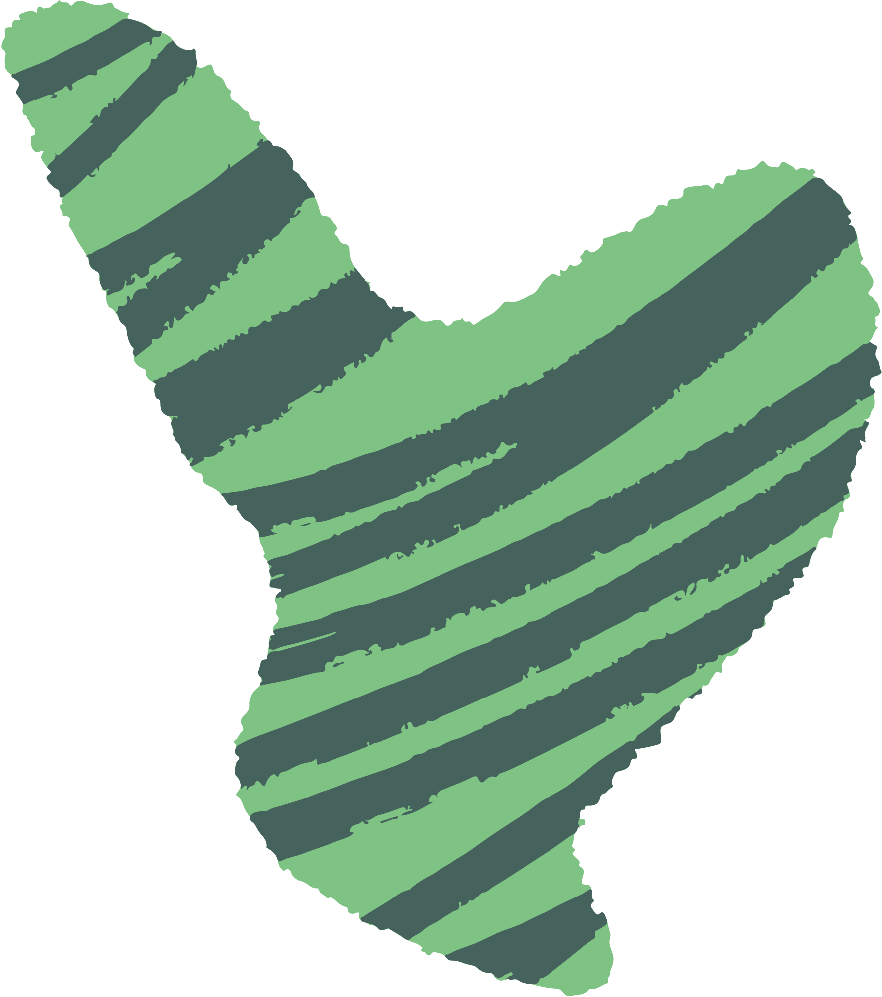
Overview of the Problem
Goals & Objectives :
Track the fish along with path of a fish.
Show how much time it visited particular parts of the tank (left/right/top/bottom/mid/center) for tests such as mirror biting.
Keep that position of fish in those areas along with for how long it’s been there.
Store positions at user defined interval into Excel (XLSX) of each fish for further analysis.
Why Object Tracking over the Object Detection ?
Lack of dataset.
Works effectively on different type of species at the same time.
Works on dyed or hybrid breeds.
No need to train the dataset.
Tracking of selective objects only for tests such as shoaling or predator test.
Control over the IDs (what to track and what not to).
Takes significantly less computing power.

Slide 5

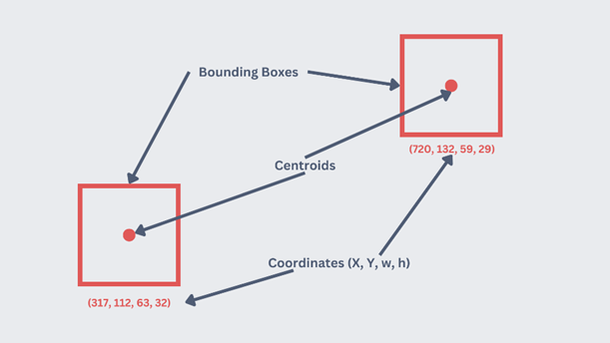
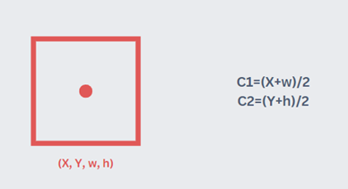

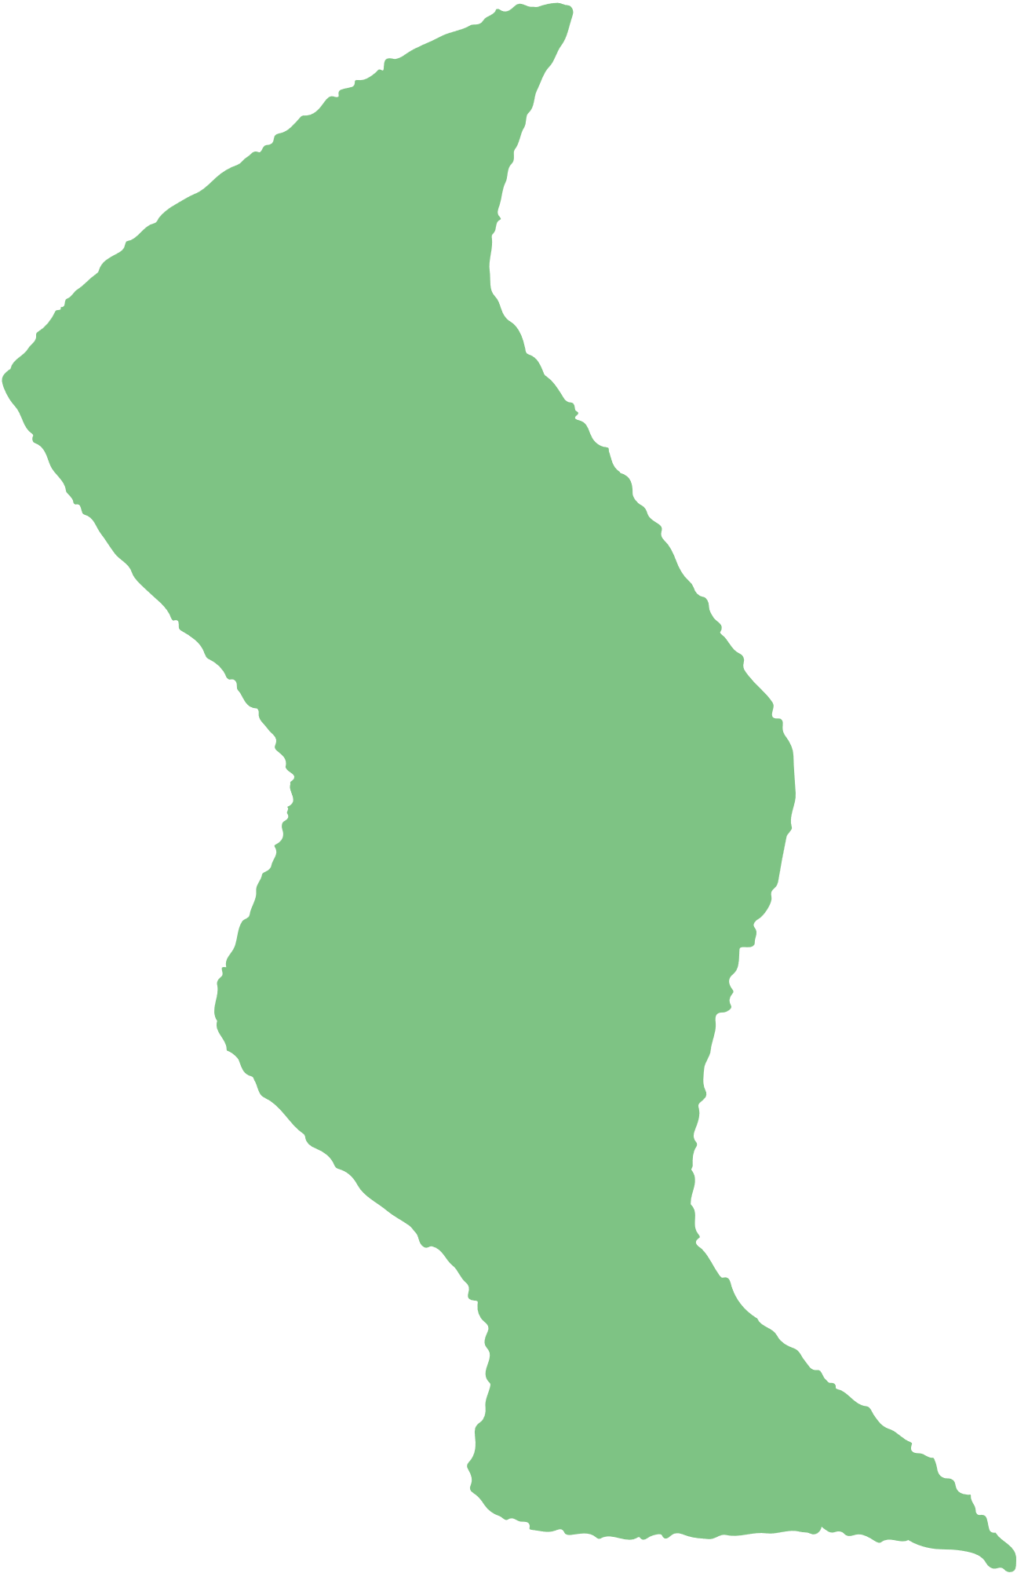

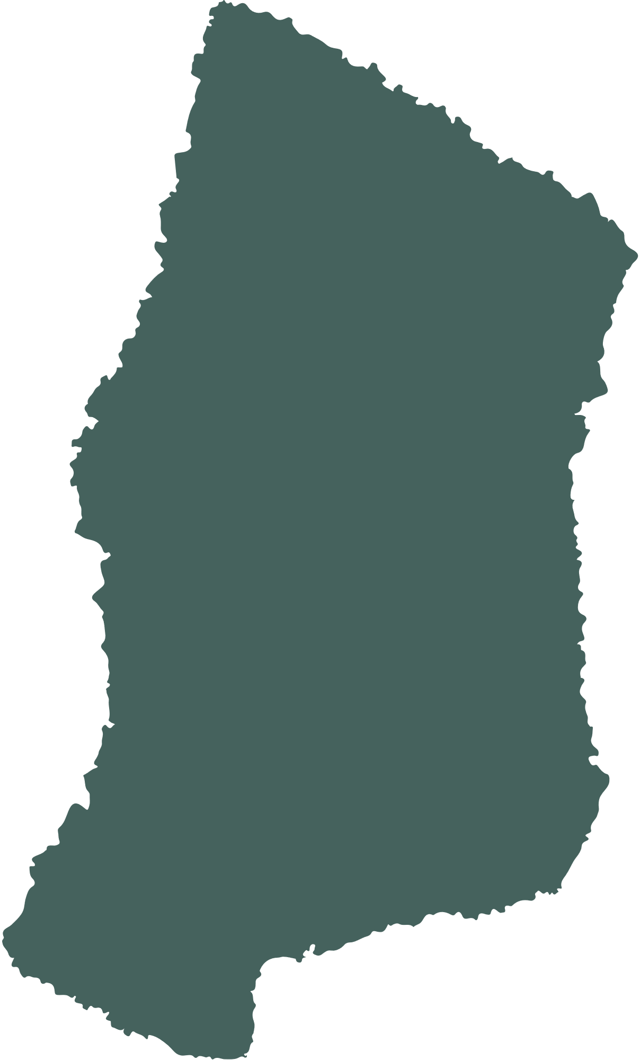
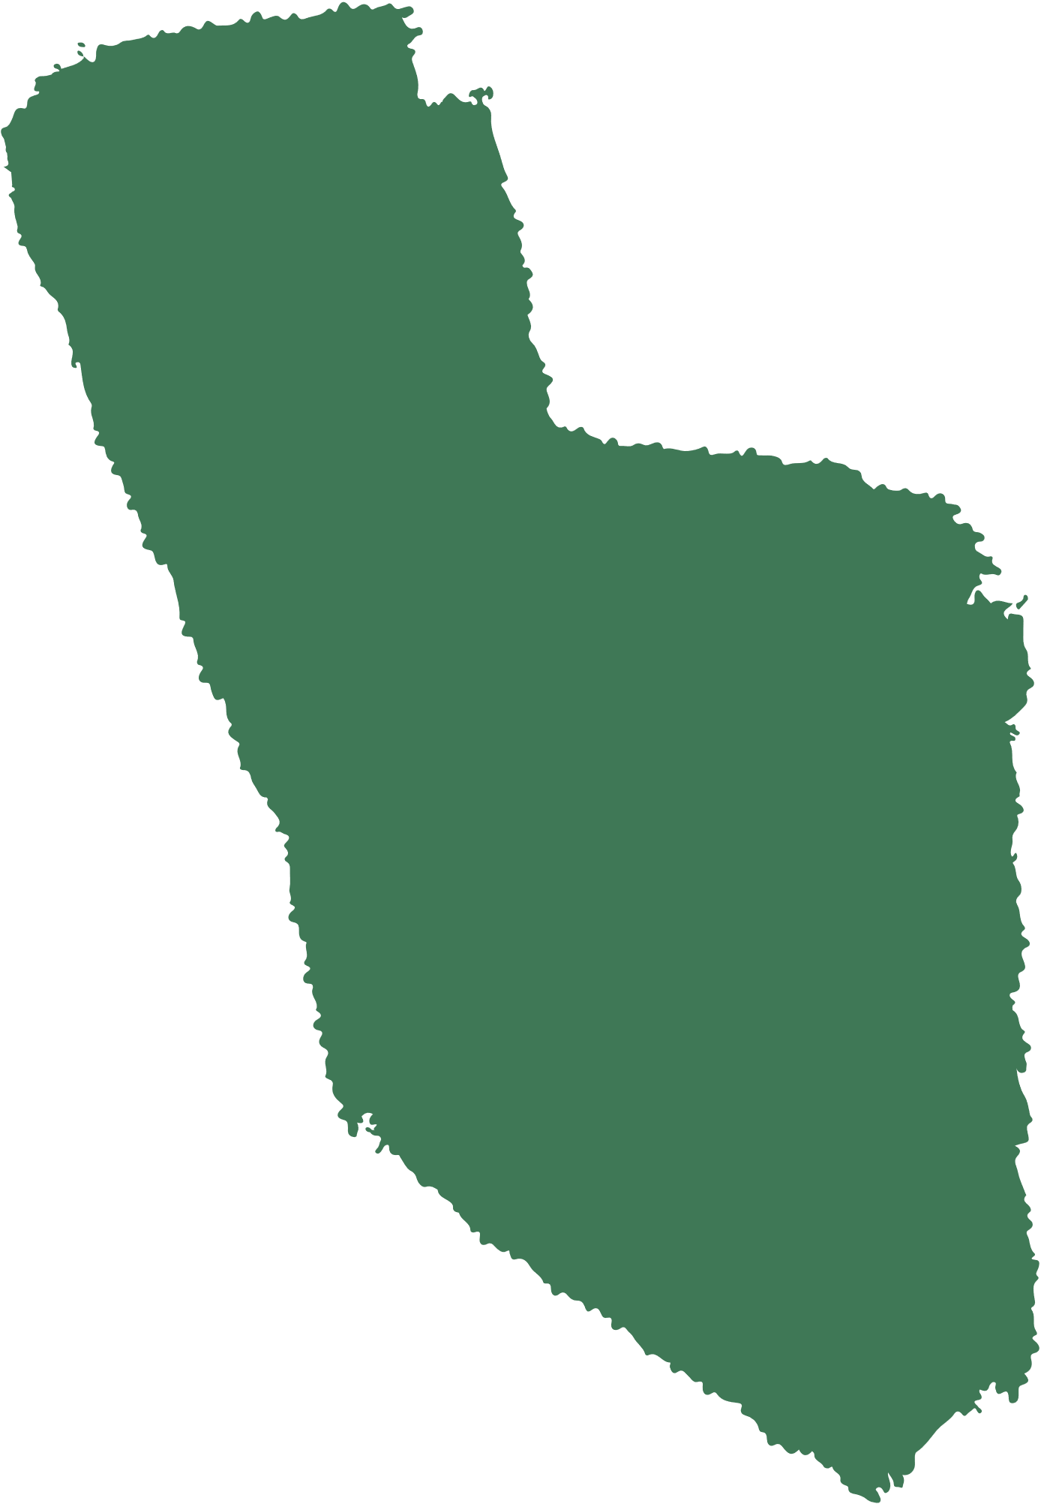



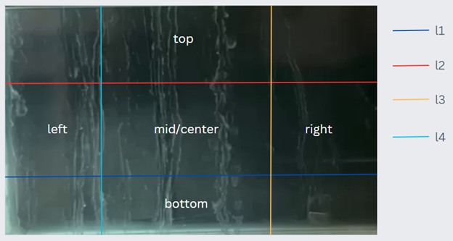
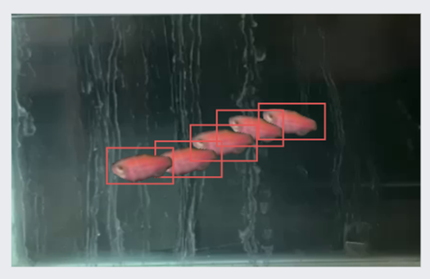







Region of Interest (ROI)
Centroids calculation
Consecutive and Subsequent Images
Traversing Positions

Slide 6

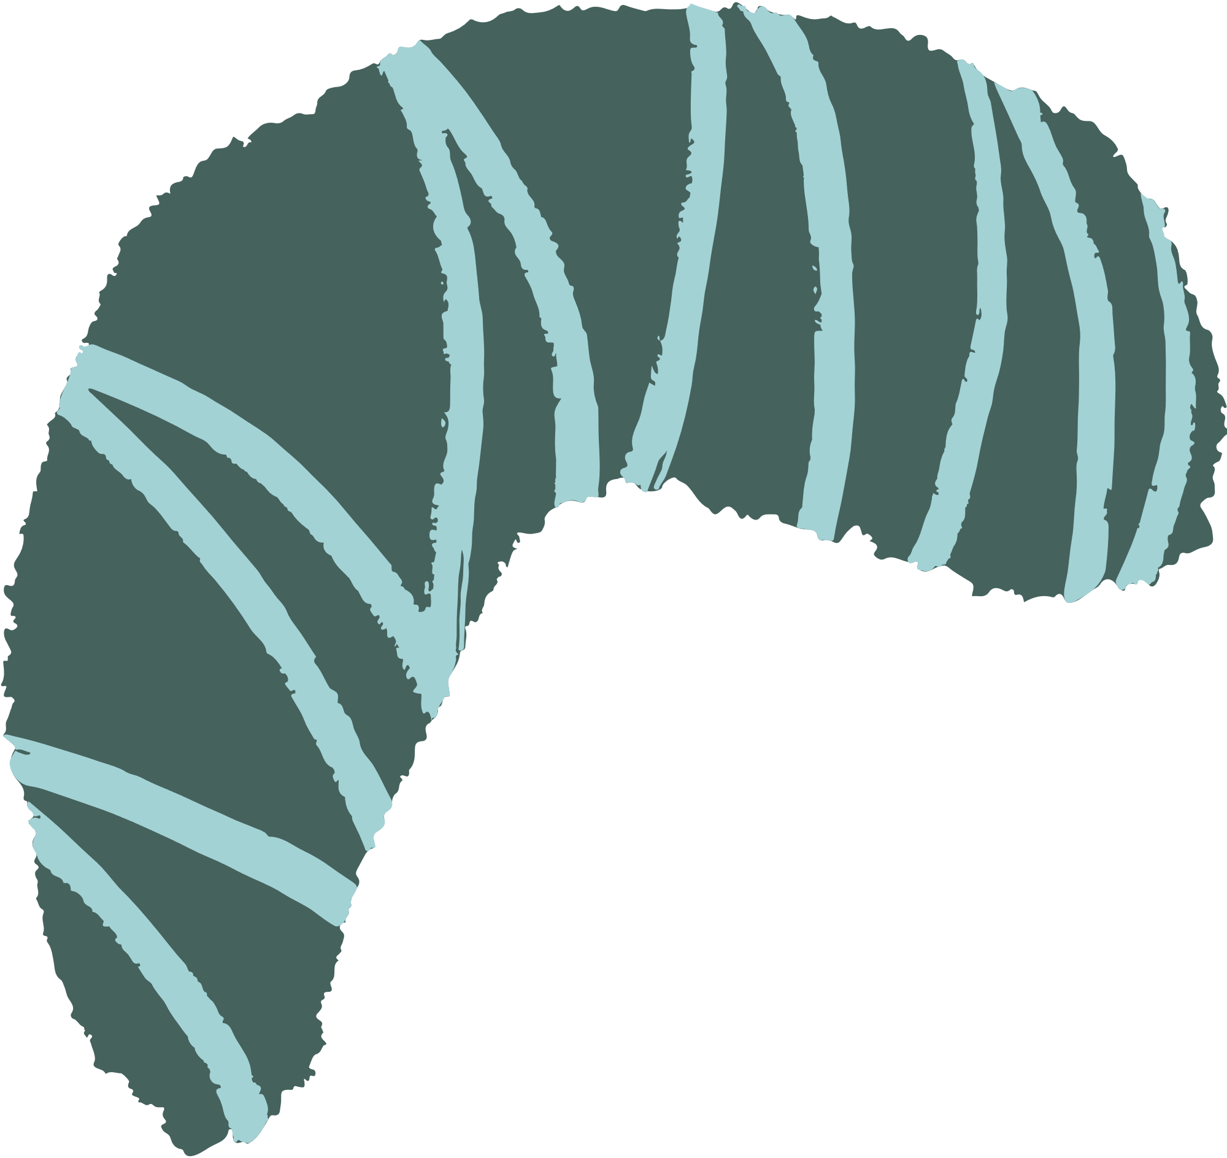
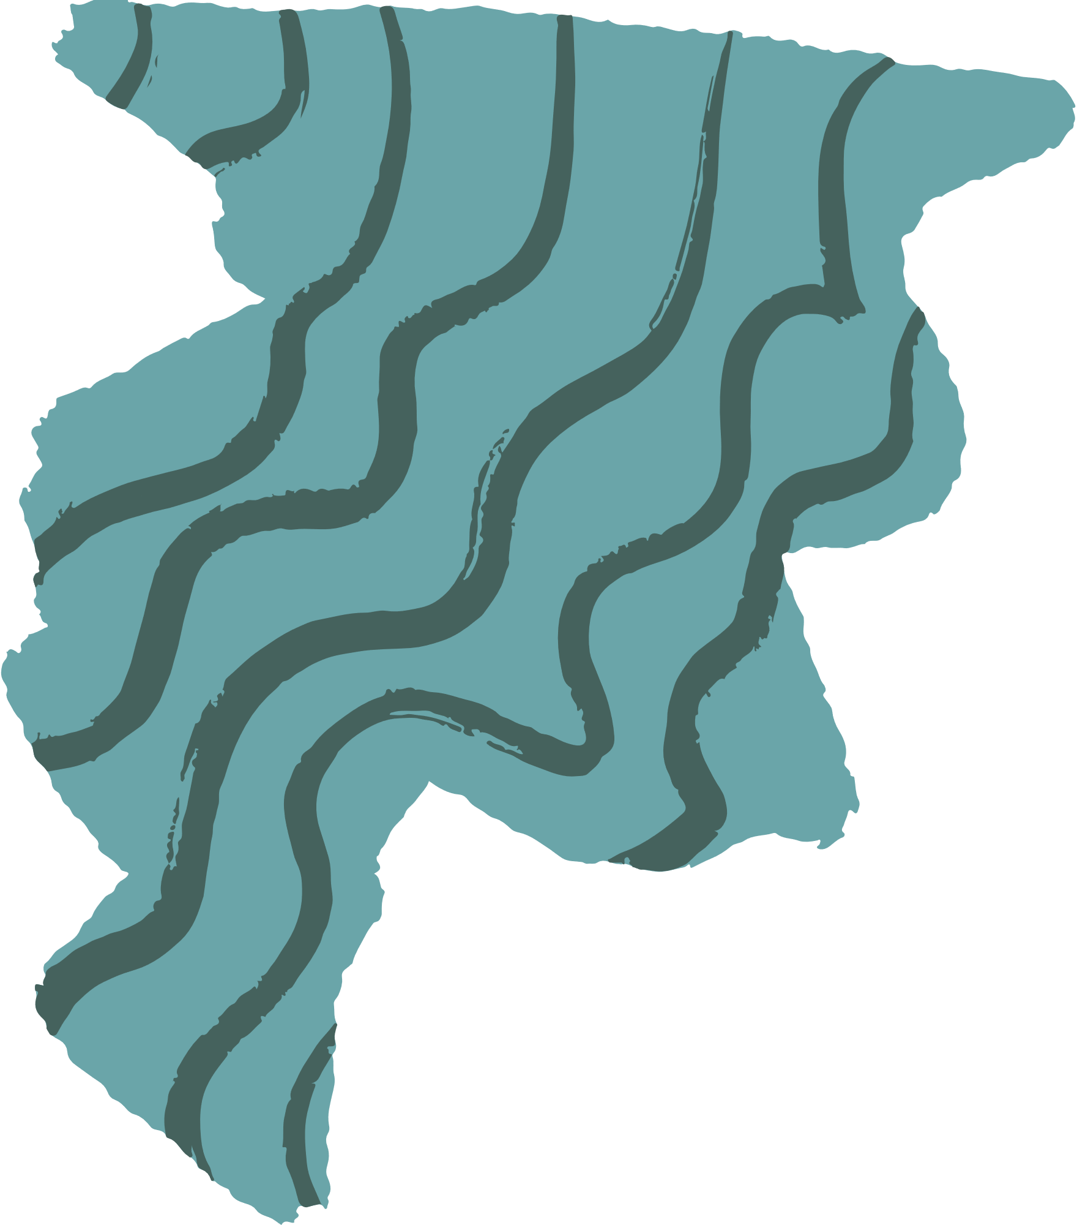

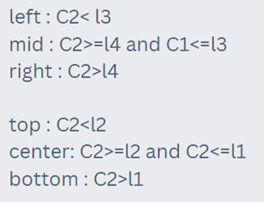

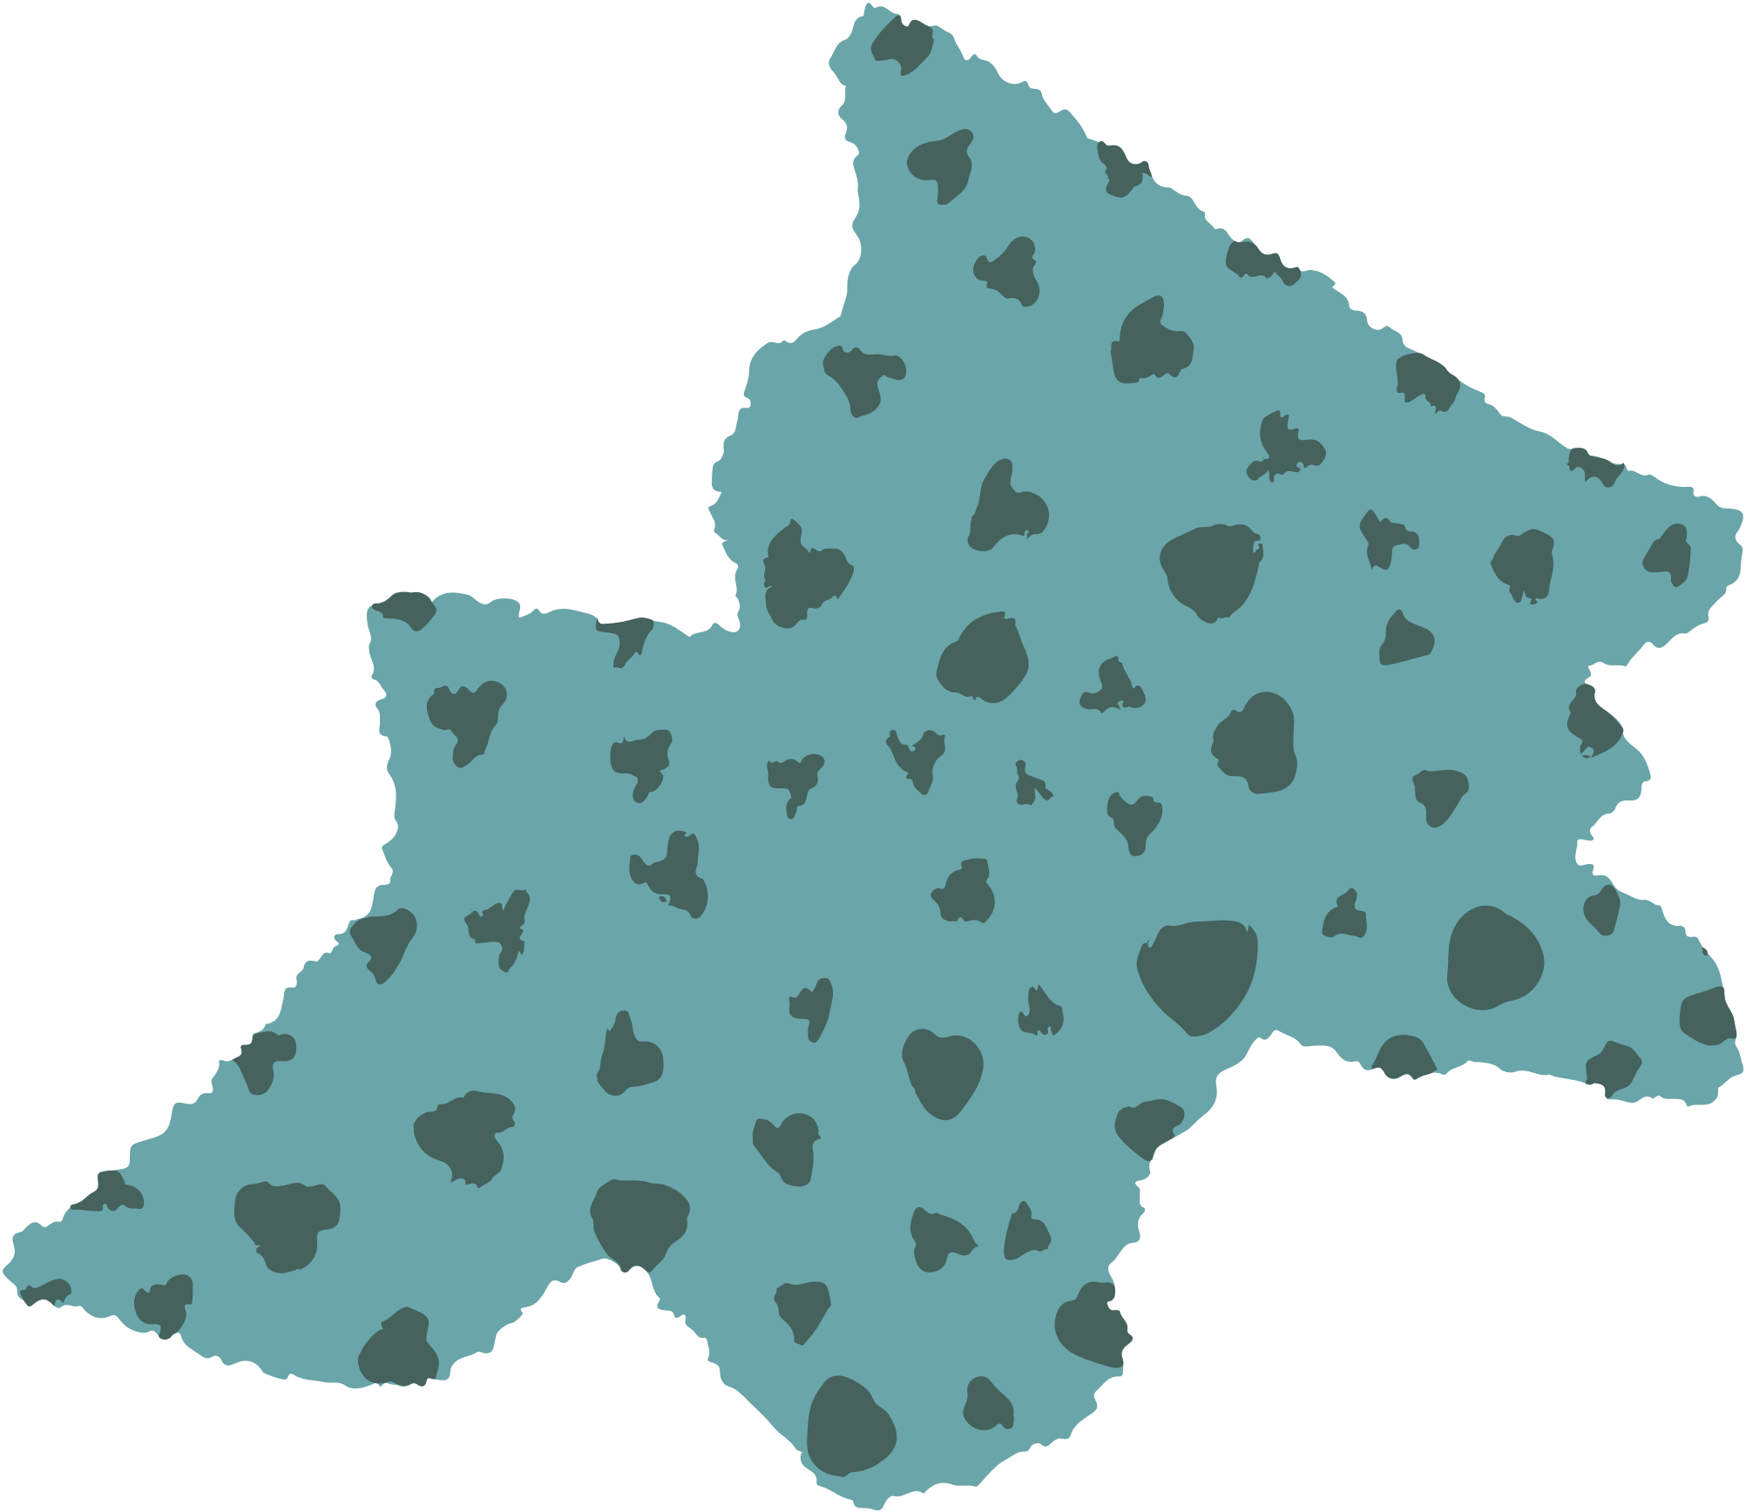

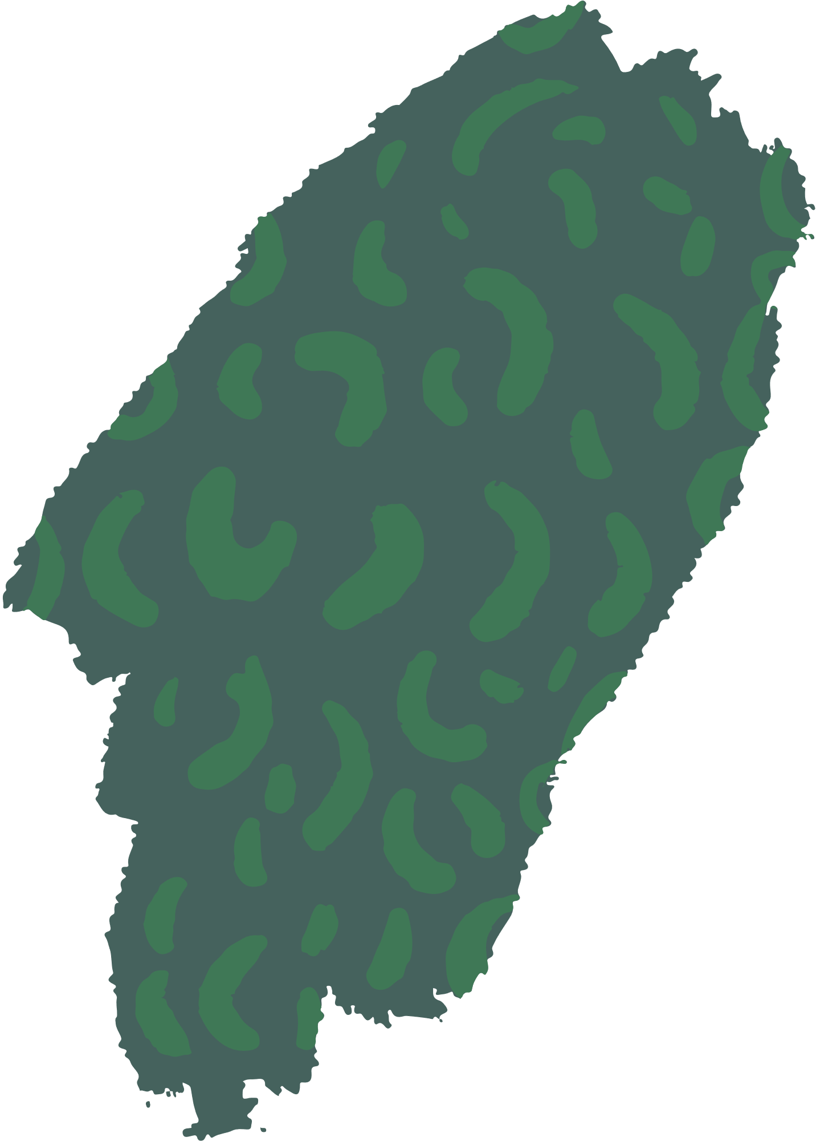
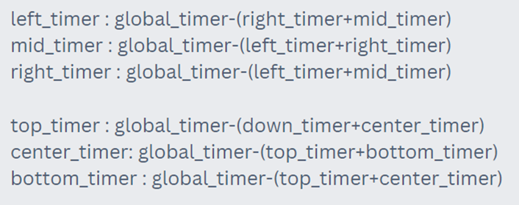
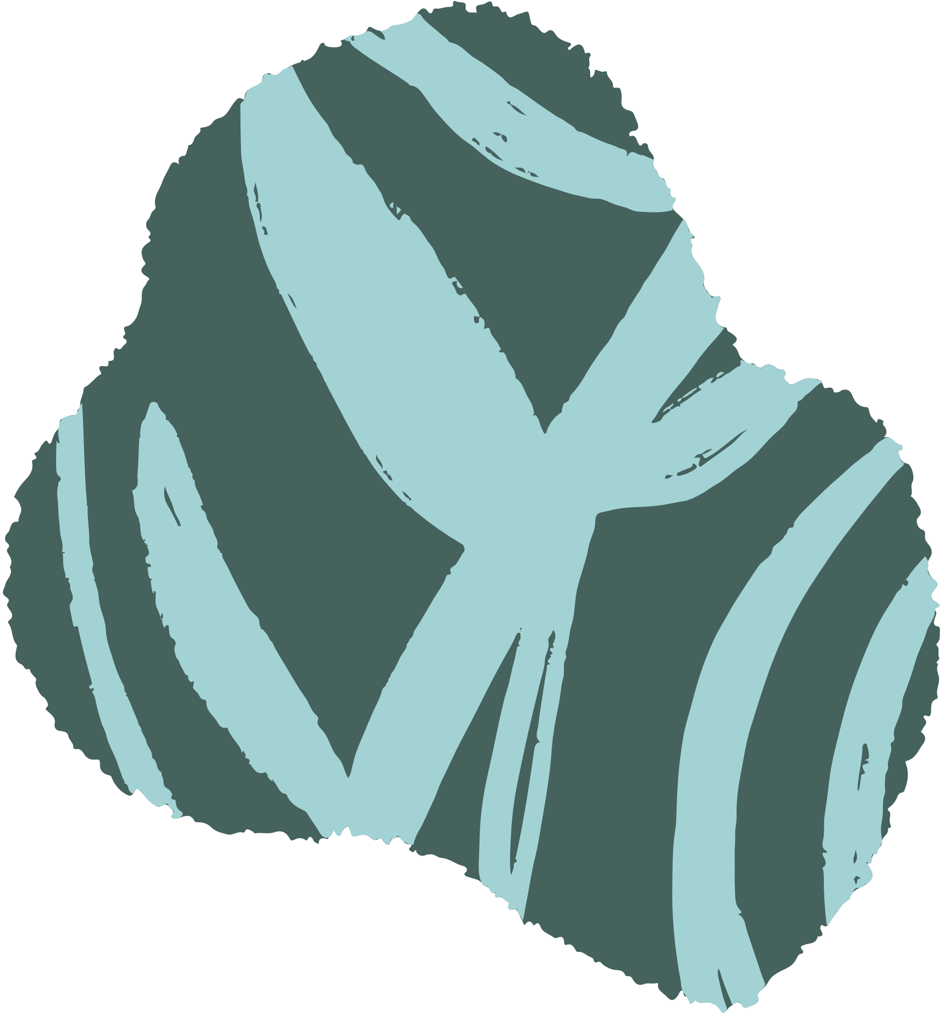
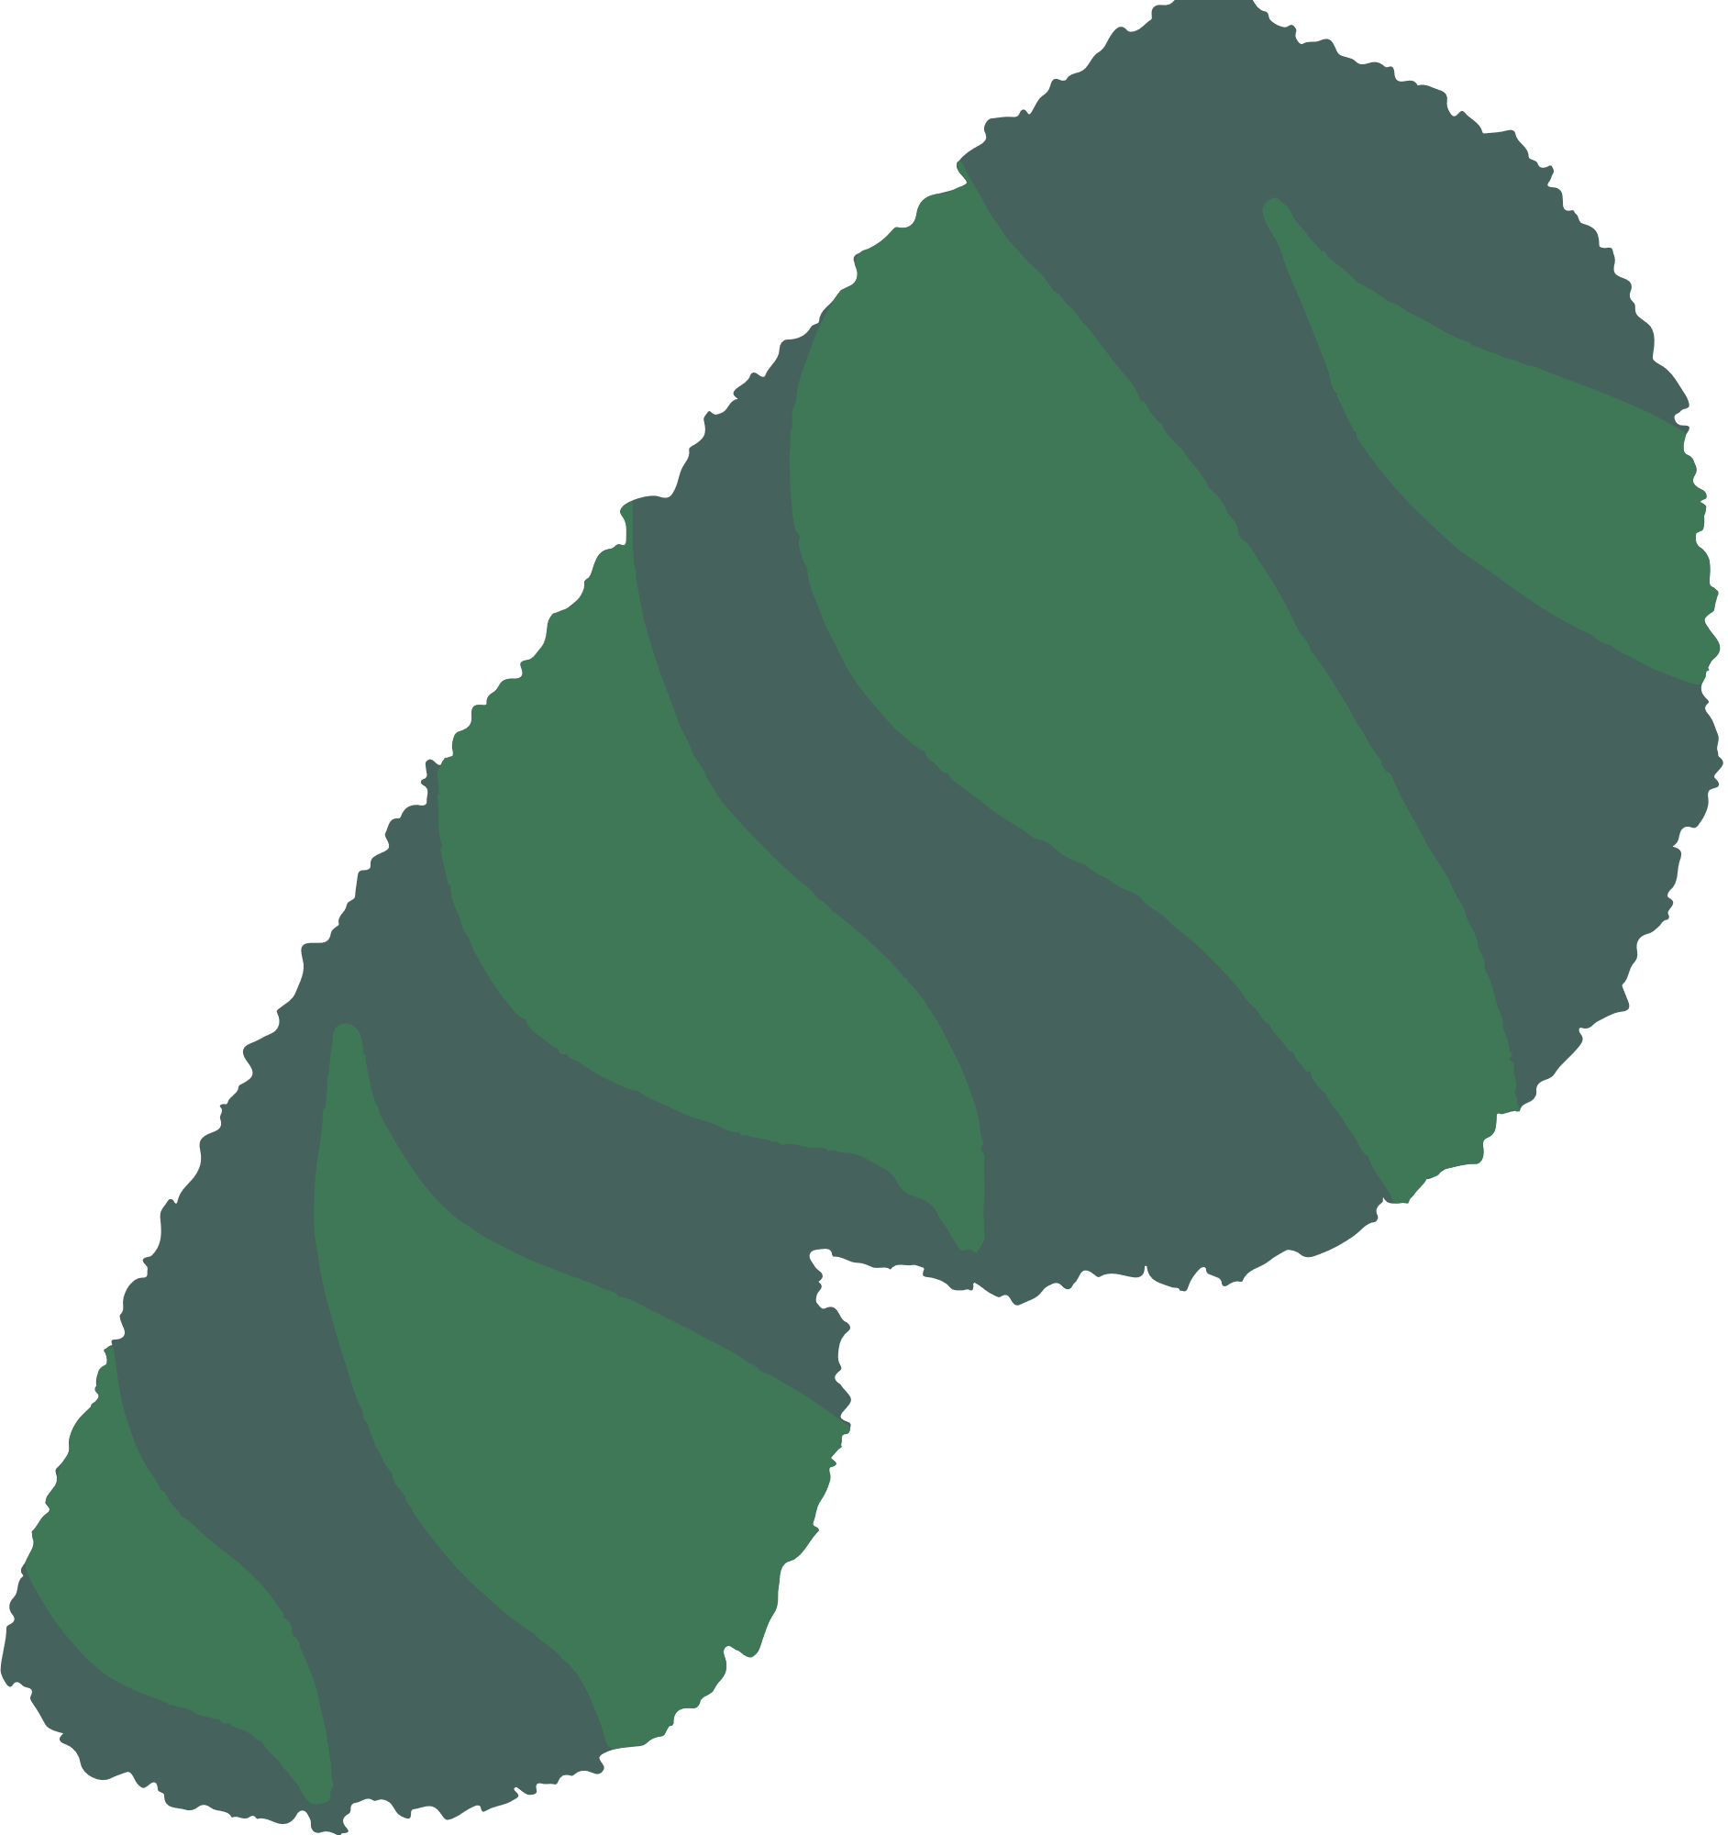
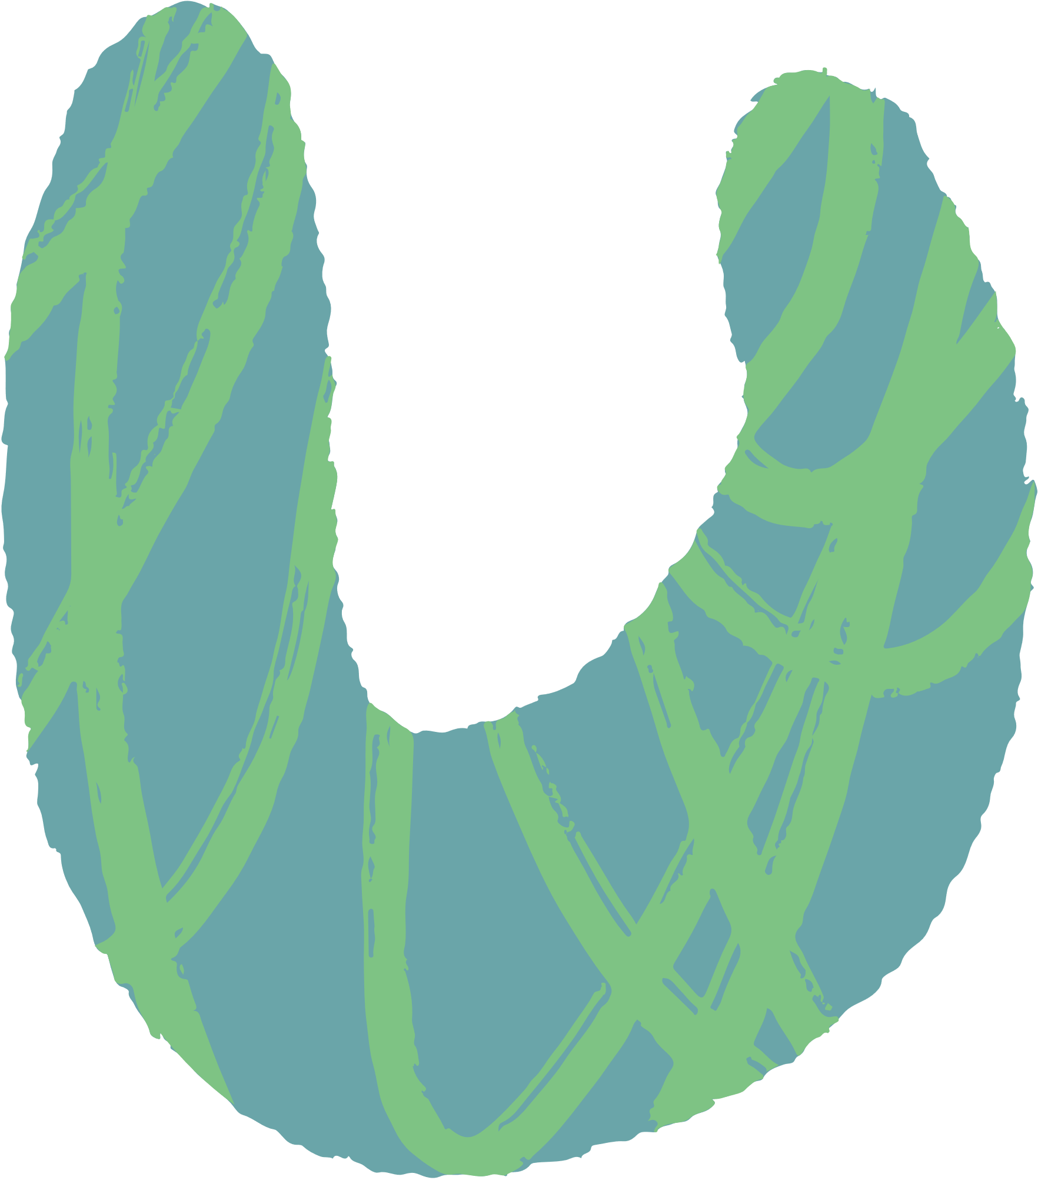

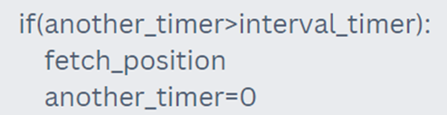
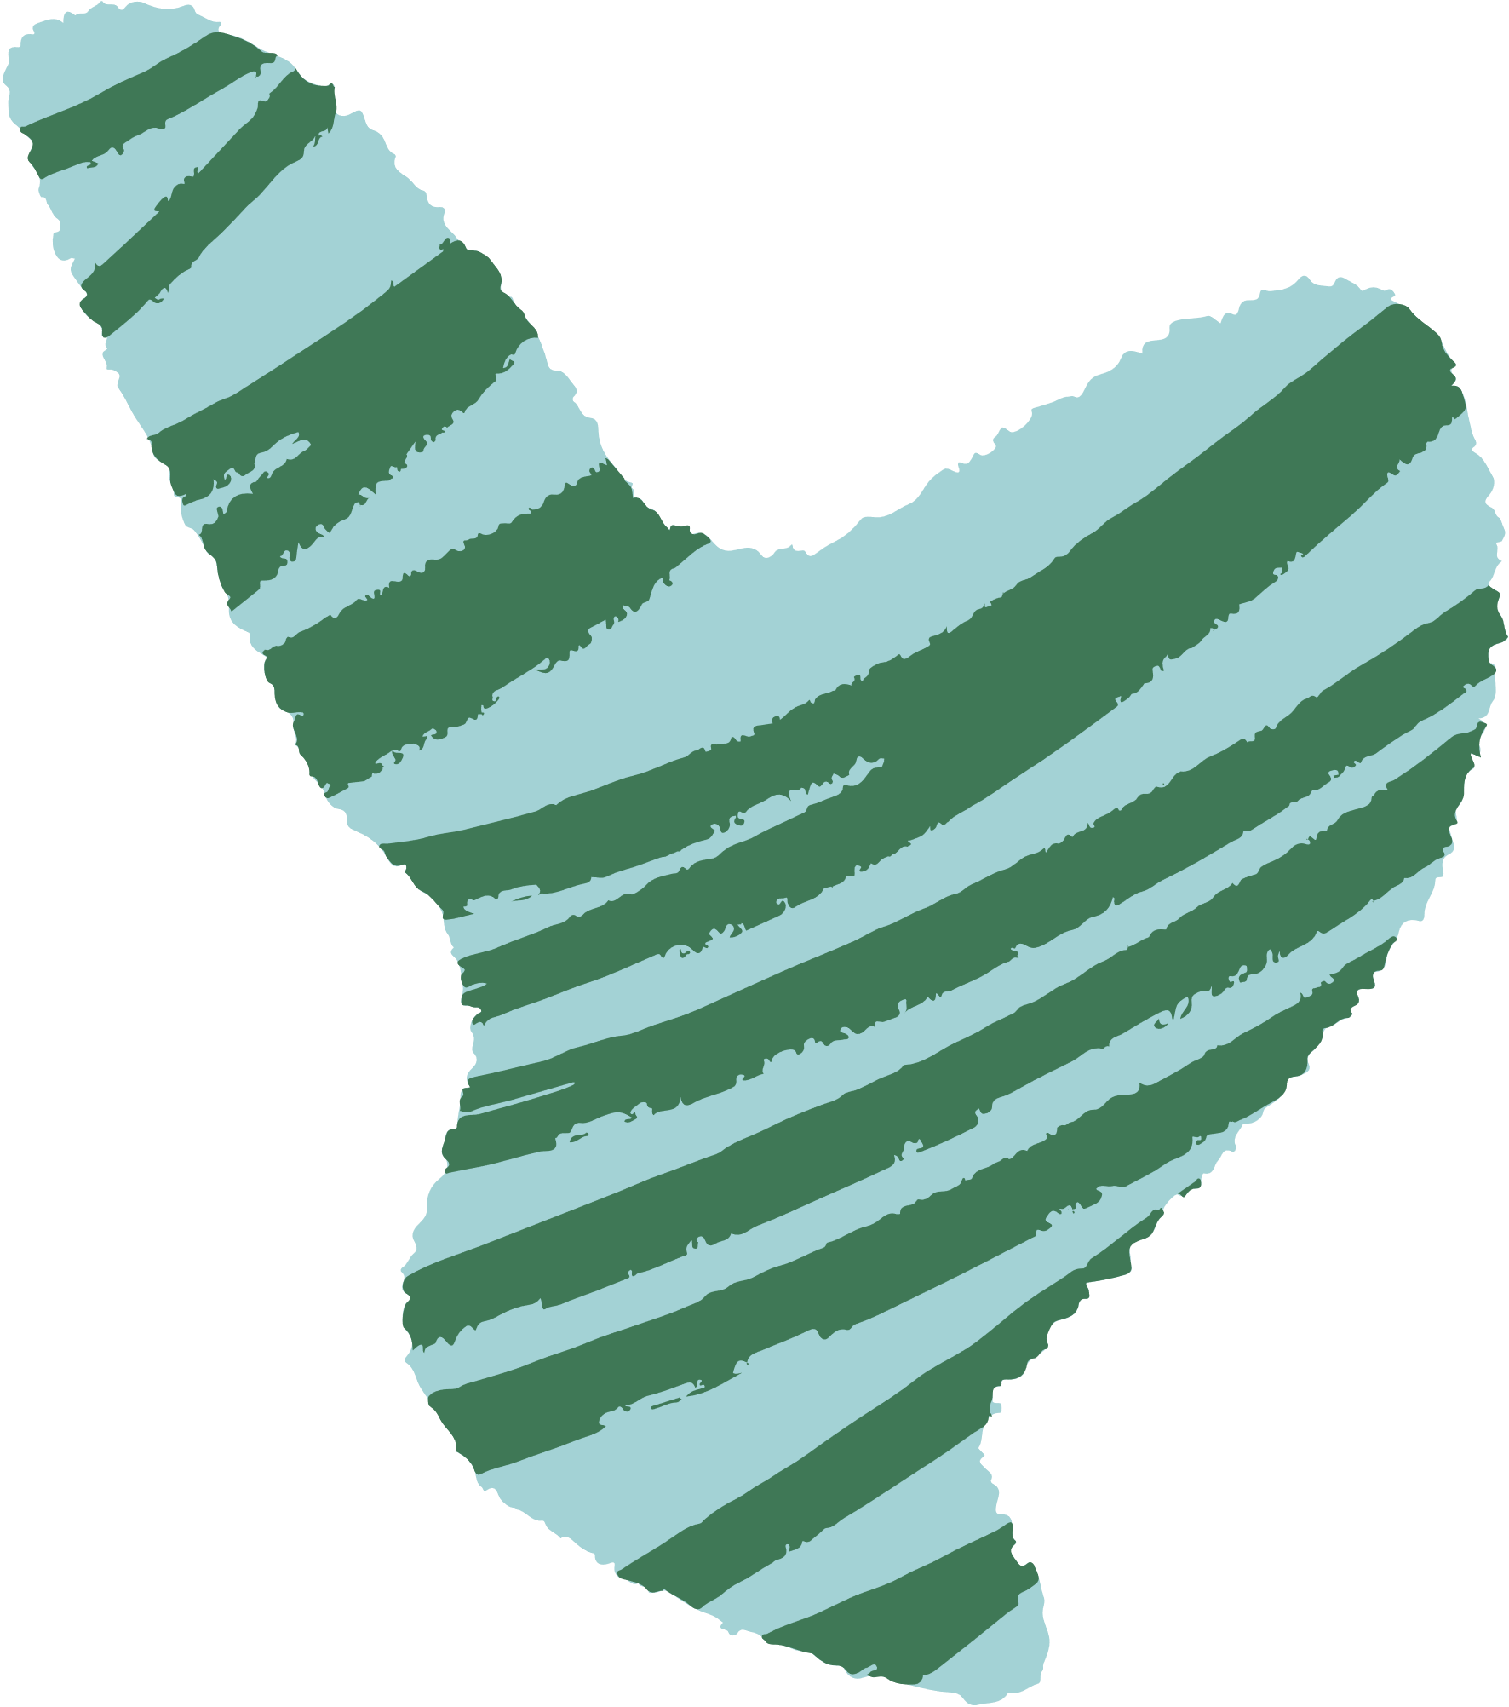
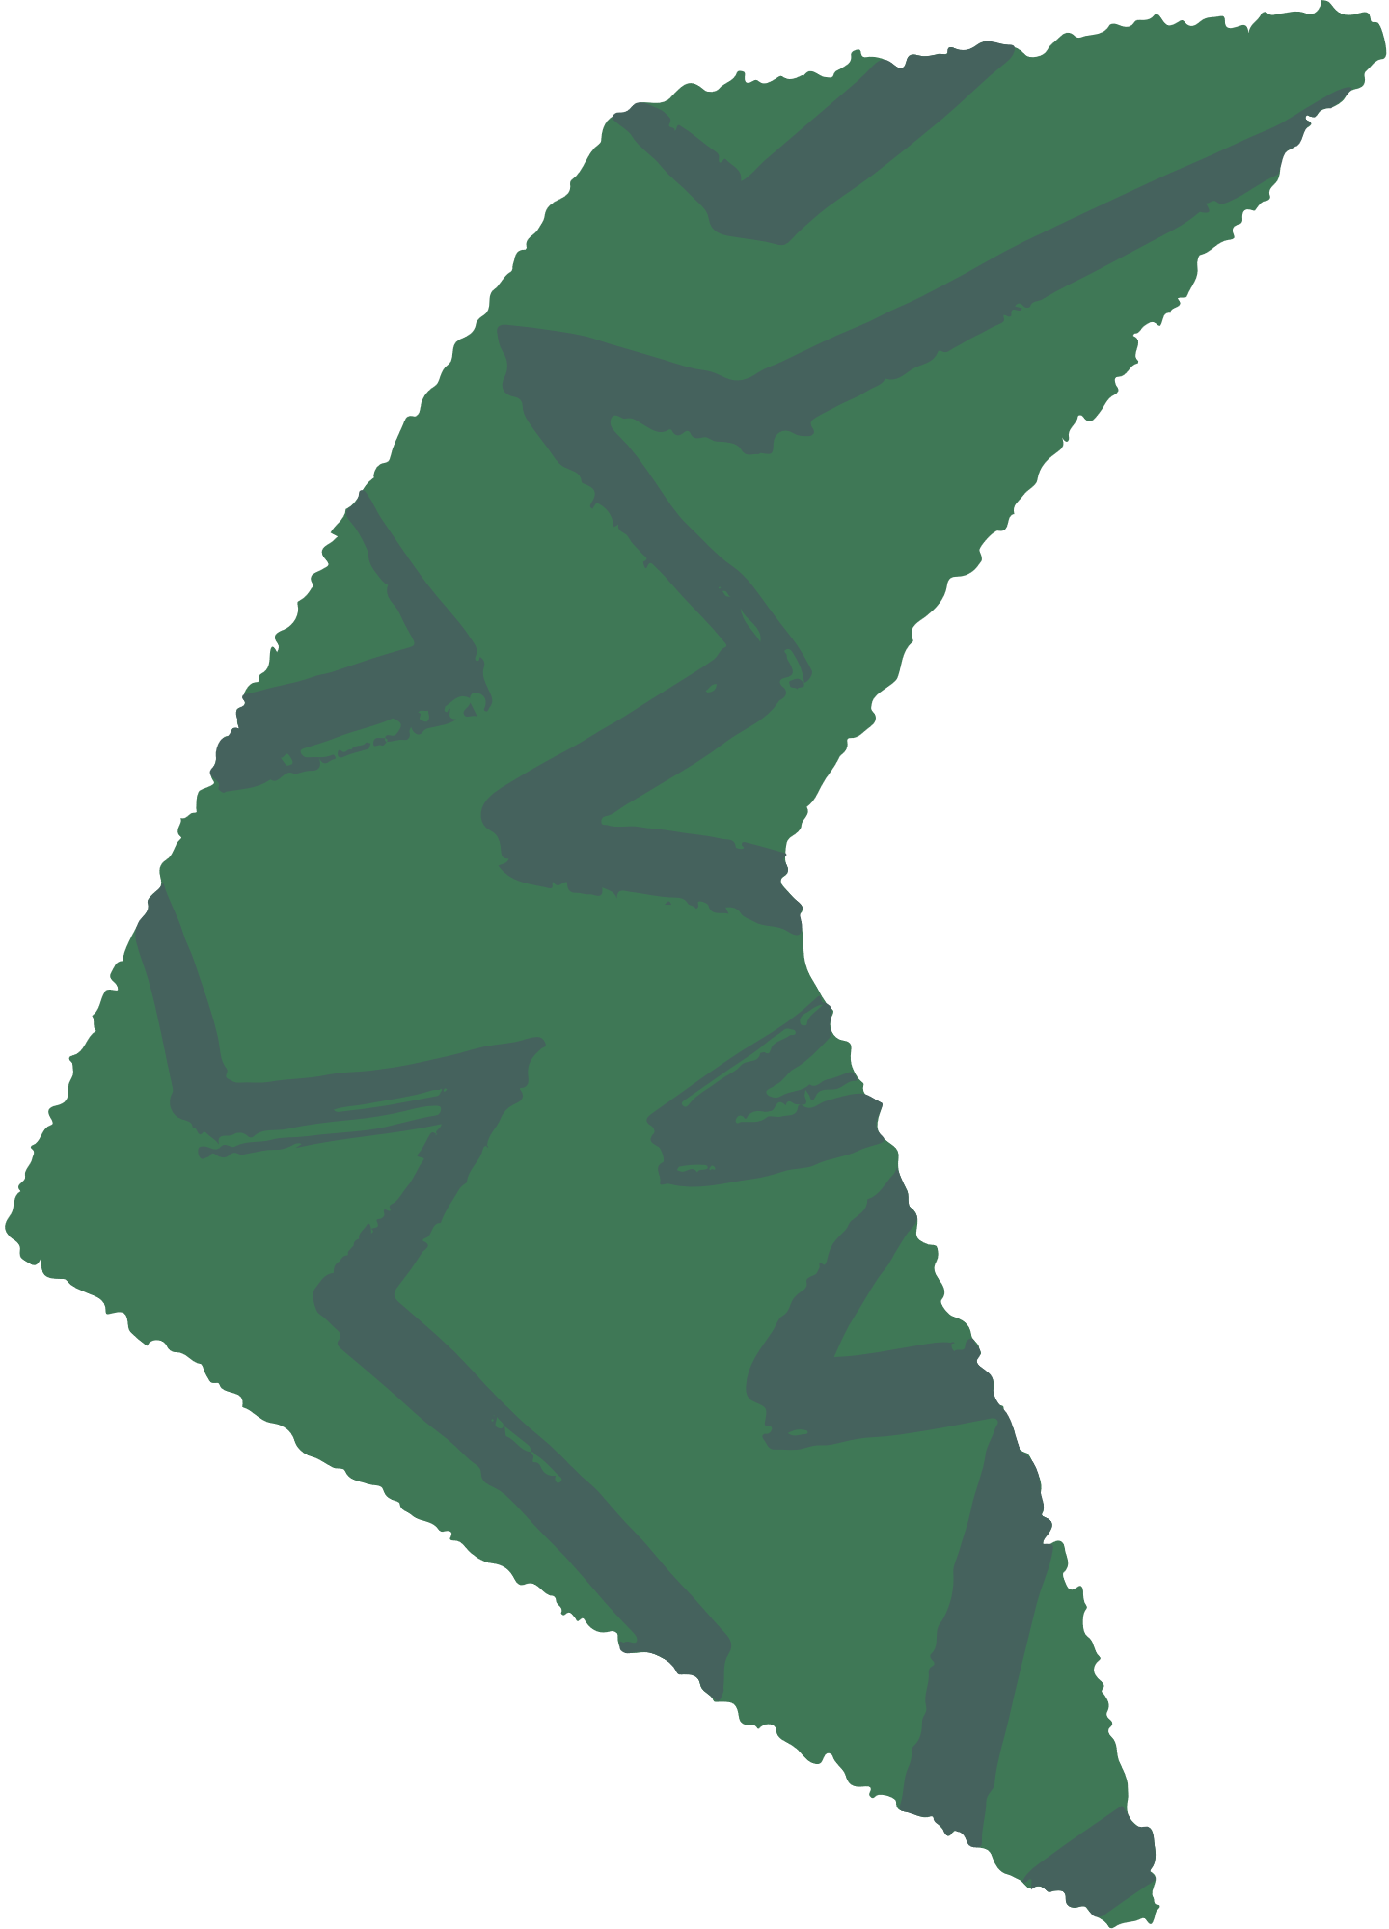


Logic and Control Flow
To check if the object is at left-middle-right or top-center-bottom and set counter for it.
Position Calculator
Along with the timers for each areas.
Timer Calculation
Since we don’t want XY position of each second but at user defined interval.
Interval Timer

Slide 7
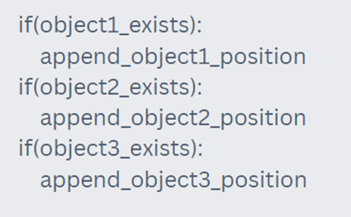
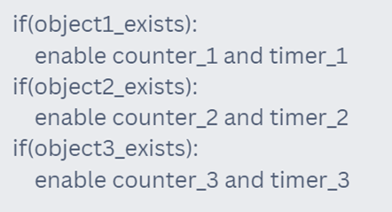
Logic and Control Flow
Append the Data
Counters and Timers Visibility
At least 1 object and up to 3 objects can be tracked.
If object exists or selected in ROI selection then only append the data.
If single or multiple object exists then show timers and counters and path tracker for that object/objects.
Different color for each BGR values by calling Random function from 0 to 255

Slide 8
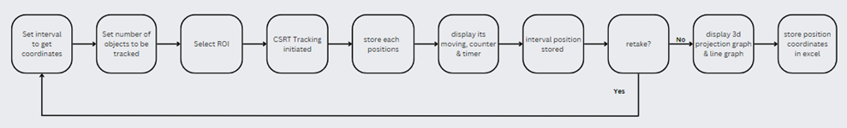
Control Flow

Slide 9
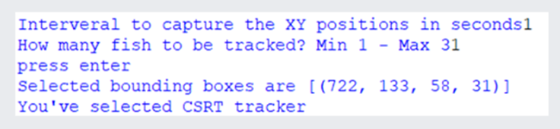
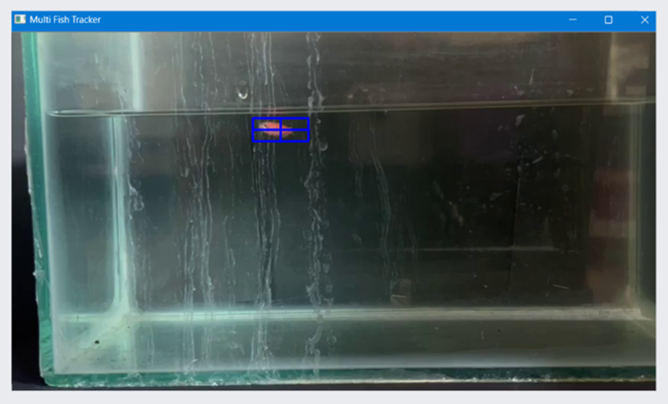
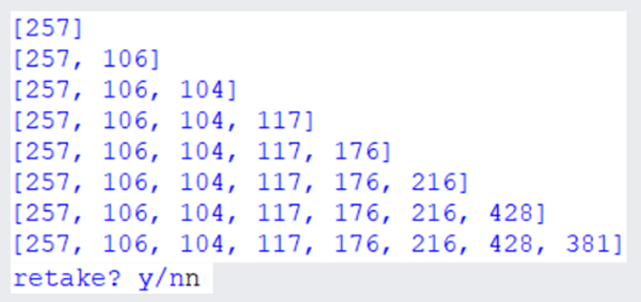
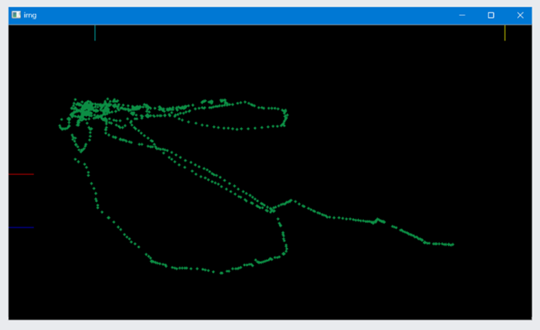
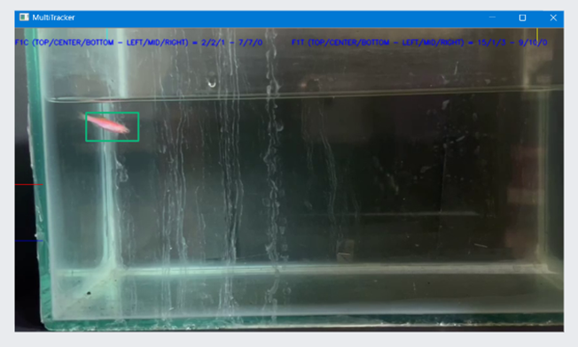
Results

Slide 10
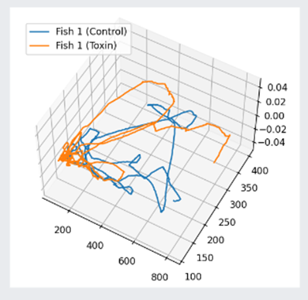
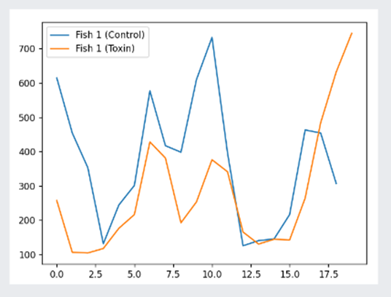
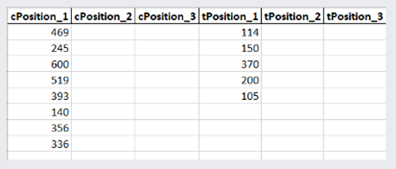
Results

Slide 11
Conculsion
Despite lot of short comings and the disadvantages of the object tracking over the object detection it is certainly an innovative way to track an object and see its behavior, unlike in object detection, it has to have prior knowledge about an object which is not the scenario in object tracking up to 75-80% accuracy and success rate for videos with descent quality of around 3 minutes duration .
Multiple fish, hybrid or dyed fish can be tracked without training a model. Scientific research can be done based on this by noticing the behavior and generated data from the tracking such as biting test, predator avoidance, anxiety of a fish.

Slide 12

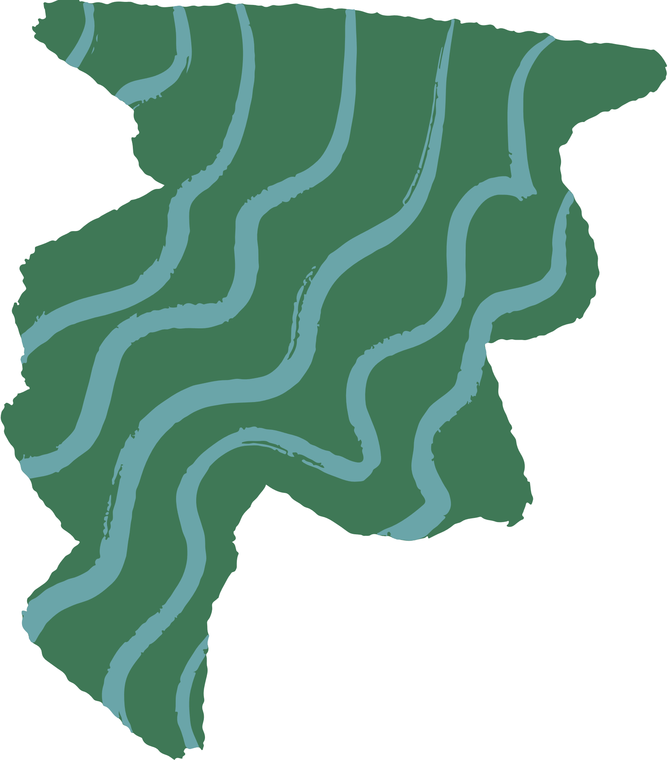
Future Enhancement
More objects for tracking along with detection of an object.
Lost tracking recovery from a specific point.
Software based approach for UI enhancement.
Various type of graphs.
3D path graph projection with the help of two cameras placing simultaneously.
Various animals apart from fish.

Slide 13
Thank You :)
GitHub Link - https://github.com/SIDDHARTH30092001/FISH_TRACKING_PROGRAM

